Slide 1
ROAD ACCIDENT ANALYSIS
USE CASES

Slide 2
Accident Trends Analysis
•Monthly Trends: Identify which months have the highest accident rates to allocate resources accordingly.
•Day of the Week Analysis: Detect patterns in accidents based on weekdays or weekends to implement targeted safety measures.
•Seasonal Impact: Assess how different weather conditions affect accident rates.
•Time-Based Patterns: Identify peak hours for accidents and recommend better traffic control measures.

Slide 3
Severity Analysis
Casualty Classification: Analyze the proportion of serious, fatal, and slight injuries to prioritize interventions.
Urban vs. Rural Impact: Evaluate whether urban or rural areas are more prone to severe accidents and tailor emergency response plans.
Speed Factor: Correlate accident severity with vehicle speed to suggest safer speed limits.

Slide 4
Vehicle Type Analysis
High-Risk Vehicle Categories: Determine which vehicle types (cars, motorcycles, taxis, etc.) are more involved in accidents.
Fleet Management: Help transport companies and logistics firms minimize accidents involving commercial vehicles.

Slide 5
Environmental and Road Condition Analysis
Weather Conditions: Identify how rain, fog, and other weather factors contribute to accidents.
Road Surface Conditions: Analyze whether wet, icy, or dry road conditions lead to more crashes.

Slide 6
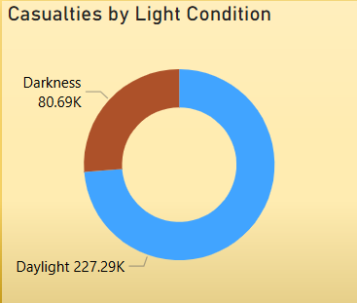
Light Condition Impact
Day vs. Night Accidents: Evaluate whether most accidents occur in daylight or darkness to enhance street lighting in high-risk areas.

Slide 7
Solutions to Reduce Road Accidents
Improve road safety infrastructure (better lighting, pedestrian crossings, pothole repairs)
Enforce stricter traffic laws (speed limits, penalties for violations)
Driver awareness programs (defensive driving, fatigue prevention)
Implement Intelligent Transport Systems (real-time traffic monitoring, smart road signs)
Optimize emergency response (faster ambulance services, medical centers near accident zones)

Slide 8
THANK YOU

